Slide 1

Analysis of
Credit Card Customer Information Dataset
By:
Nayan Bhiwapurkar,
Kaumudi Patil,
Shreyas Hingmire,
Sharan Patel

Slide 2
Introduction
Significance of Credit Cards:
Fundamental in today's financial landscape.
Key determinant of consumer behavior and financial decision-making.
Importance for Financial Institutions:
Essential to study credit card user behavior for strategic decision-making, profitability, and customer satisfaction.
Research Objective:
Derive insights from a comprehensive credit card customer information dataset.
Financial institutions can optimize services and offerings with the help off objective.

Slide 3
Data Collection and Characteristics
Spans 2018 and 2019, providing a comprehensive snapshot.
Customer Information: Encompasses demographics (client numbers, ages, genders) and financials (incomes, credit limits, card categories).
Focus Variables for Analysis:
Credit_Limit: Reflects credit extended to customers.
Attrition_Flag: Crucial for identifying customer attrition.
Avg_Utilization_Ratio: Average card utilization, an essential metric for analysis.
Behavior Metrics:
Transaction counts, months of inactivity, and contact frequency captured.
Facilitates a holistic view of customer interactions.

Slide 4
Problems in Dataset
Data Imbalance:
The Credit_Limit column contained outliers.
We removed these outliers as these could influence the Hypothesis.
Feature Selection:
Analyzed correlations and distributions of features.
We removed some features which did not contribute much to the hypothesis testing.

Slide 5
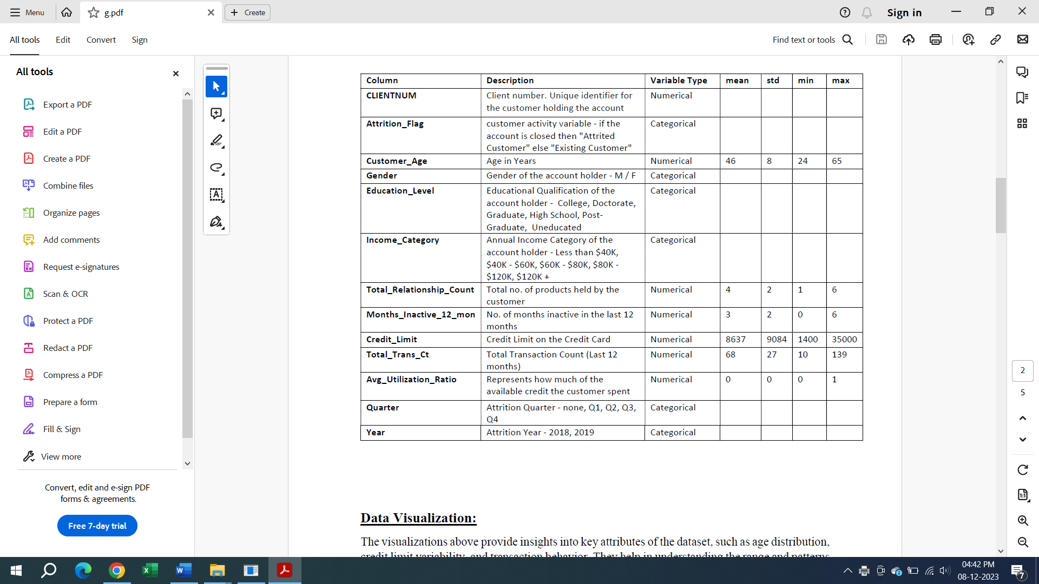
EDA and Attribute understanding

Slide 6
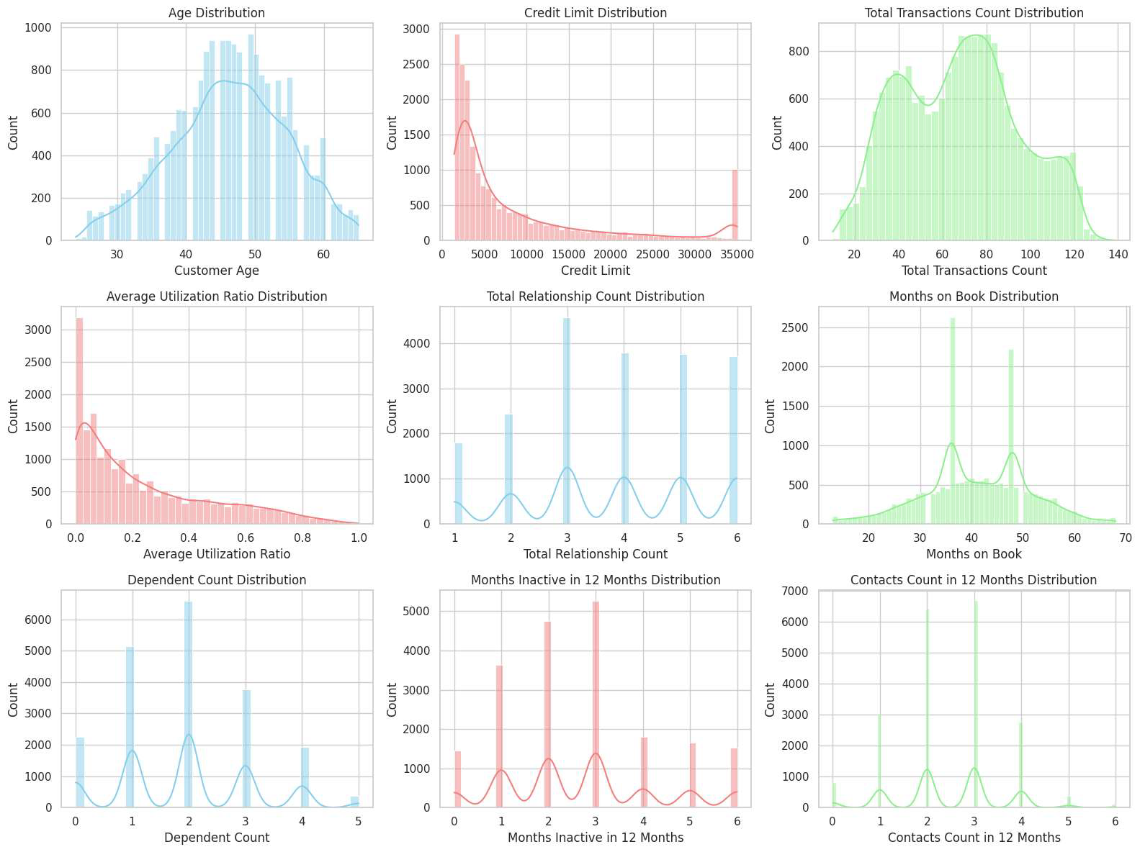
Data Visualization

Slide 7
Hypothesis of Interest
First Hypothesis investigates whether there is a significant gender disparity among individuals with high credit limits or is there any other factor which influences credit Limit.
Second hypothesis explores the potential relationship between credit card utilization and the likelihood of customers experiencing attrition

Slide 8
Importance of Solution
Strategic Decision Making:
Serves as a crucial guide for strategic decision-making in the financial sector
Goes beyond surface-level statistics, providing a nuanced understanding of consumer behavior in credit card services.
Enables stakeholders to proactively address challenges and capitalize on emerging opportunities.
Fosters a proactive approach, ensuring the sustained relevance and competitiveness of credit card services in a dynamic market.

Slide 9
Importance of Solution
Risk Mitigation and Customer Satisfaction
Plays a pivotal role in identifying early warning signs of attrition.
Enables financial institutions to implement targeted retention strategies for minimizing financial impact.
Tailors services based on a deep understanding of customer preferences and behaviors.
Fosters long-term loyalty by meeting evolving customer expectations.

Slide 10
Hypothesis Test - 1
Objective:
To test whether the percentage of males within the population having a credit limit exceeding $25,000 surpasses 90%.
Null Hypothesis (H0): H0: p ≥ 0.90
The percentage of males within the population having a credit limit exceeding $25,000 is greater than 90%
Alternative Hypothesis (H1): H1: p < 0.90
The percentage of males within the population having a credit limit exceeding $25,000 is less than 90%.

Slide 11
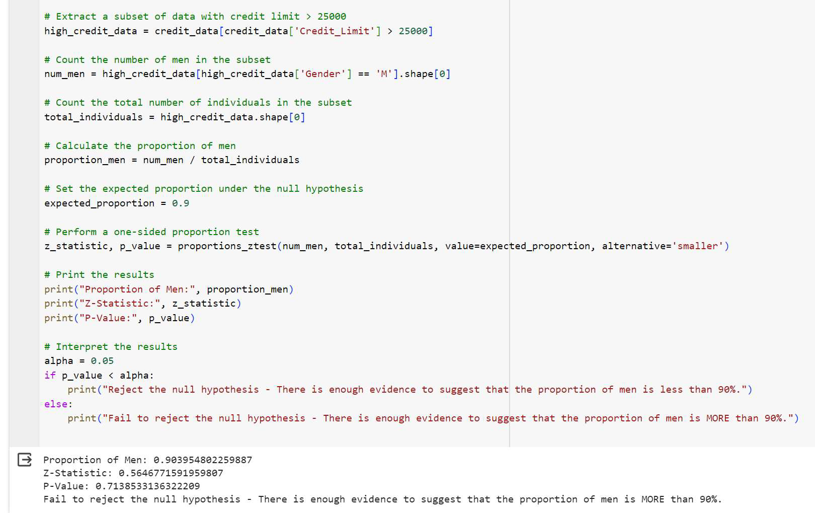
Z - Test for our hypothesis testing.

Slide 12
Decision
Proportion of Men: 0.903954802259887
Z-Statistic: 0.5646771591959807
P-Value: 0.7138533136322209
Fail to reject the null hypothesis.
There is enough evidence to suggest that the percentage of males within the population having a credit limit exceeding $25,000 is MORE than 90%.

Slide 13
Deeper Analysis
While exploring the factors influencing credit limits, we investigated various variables. We wanted to find if ‘Gender’ really affects credit limit or not, and is ‘Gender’ the only factor impacting credit limits.
Instead, we observed a strong correlation between credit limits and two key factors: Education Level and Income Category.
Specifically, individuals with higher education levels tend to belong to higher income categories, and those in higher income categories generally have higher credit limits.
This suggests that Education Level and Income Category play pivotal roles in determining credit limits, overshadowing any discernible influence from gender.

Slide 14
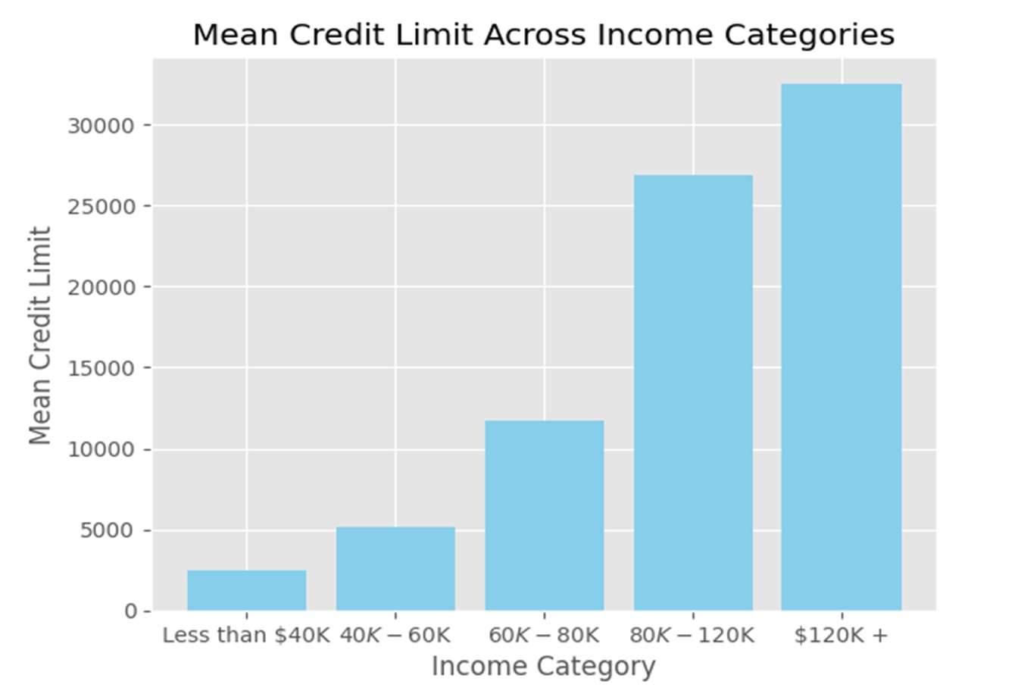
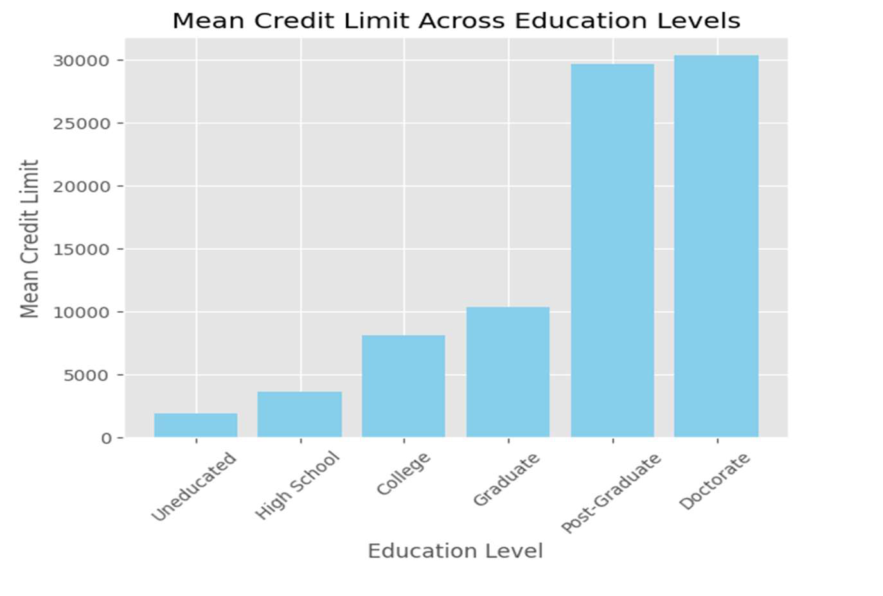

Slide 15
Chi-square test:
Next, we wanted to find whether ‘Gender’ directly affects the ‘Credit Limit.’
So, we decided to perform Chi-square test to find out if there is any relation between gender and credit limit.
Objective:
To test whether there is an association between gender and credit limit among individuals with a credit limit greater than 25,000.
Null Hypothesis (H0):
H0: There is no association between gender and credit limit.
Alternative Hypothesis (H1):
H1: There is an association between gender and credit limit.

Slide 16
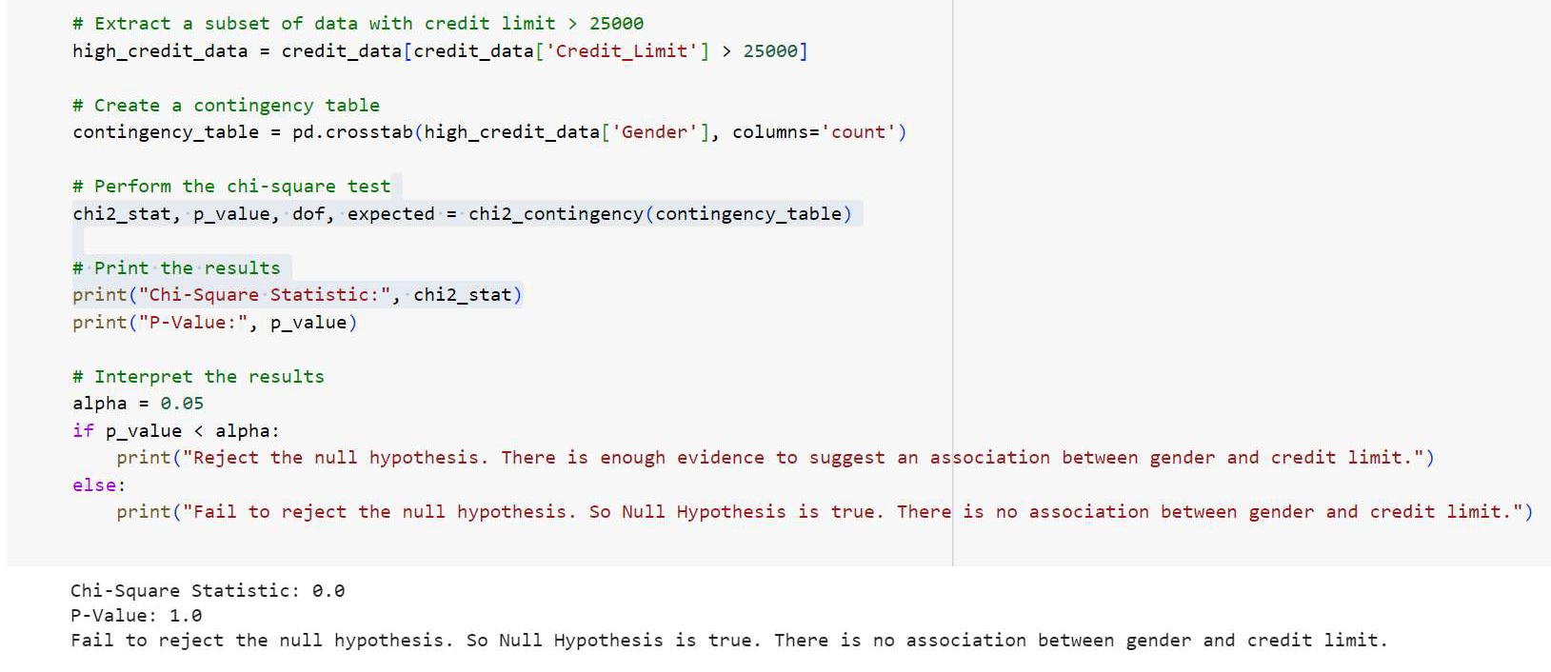
Code Snippet for Chi-Square test in hypothesis-1

Slide 17
Decision
p-value: 1.0
Fail to reject the null hypothesis.
So Null Hypothesis is true.
There is not enough evidence to suggest an association between gender and credit limit.
Hence, gender does not play pivotal role in deciding the credit limit, but education level and salary surely affects the credit limit.

Slide 18
Hypothesis Test - 2
Objective:
To assess whether the utilization ratio has a significant effect on the likelihood of a customer being classified as attrited.
Null Hypothesis (H0):
The utilization ratio has no effect on the likelihood of being an attrition customer.
Alternative Hypothesis (H1):
If a person has a utilization ratio less than 0.5, then the chances of being an attrition customer are higher.

Slide 19
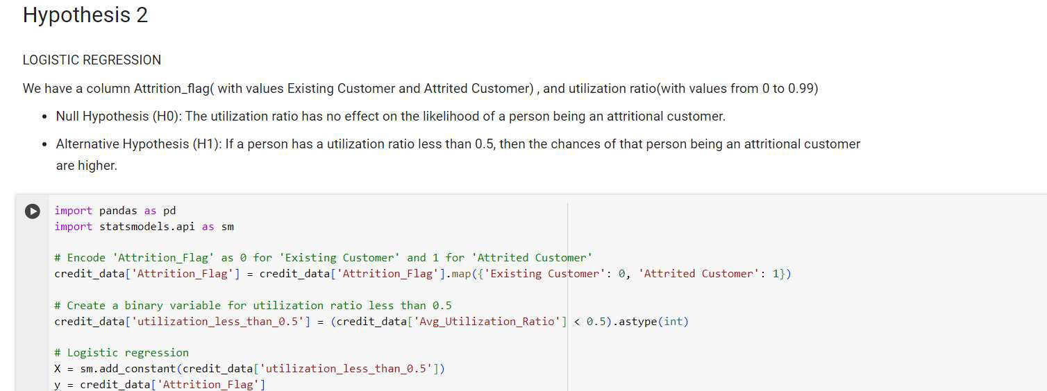
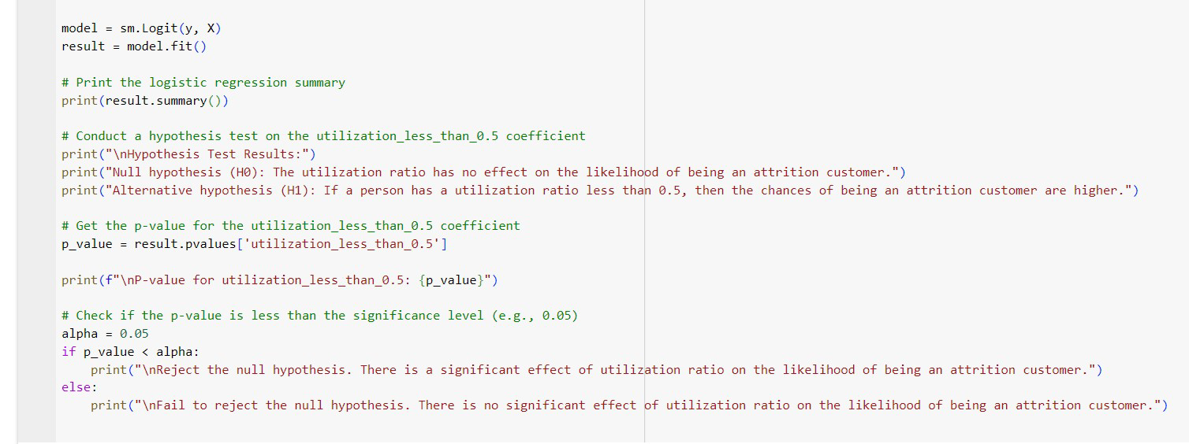
Logistic Regression to test our hypothesis-2

Slide 20
Decision
p-value for utilization_less_than_0.5: 1.1463332660313418e-12
Reject the null hypothesis.
There is a significant effect of utilization ratio on the likelihood of being an attrition customer.

Slide 21
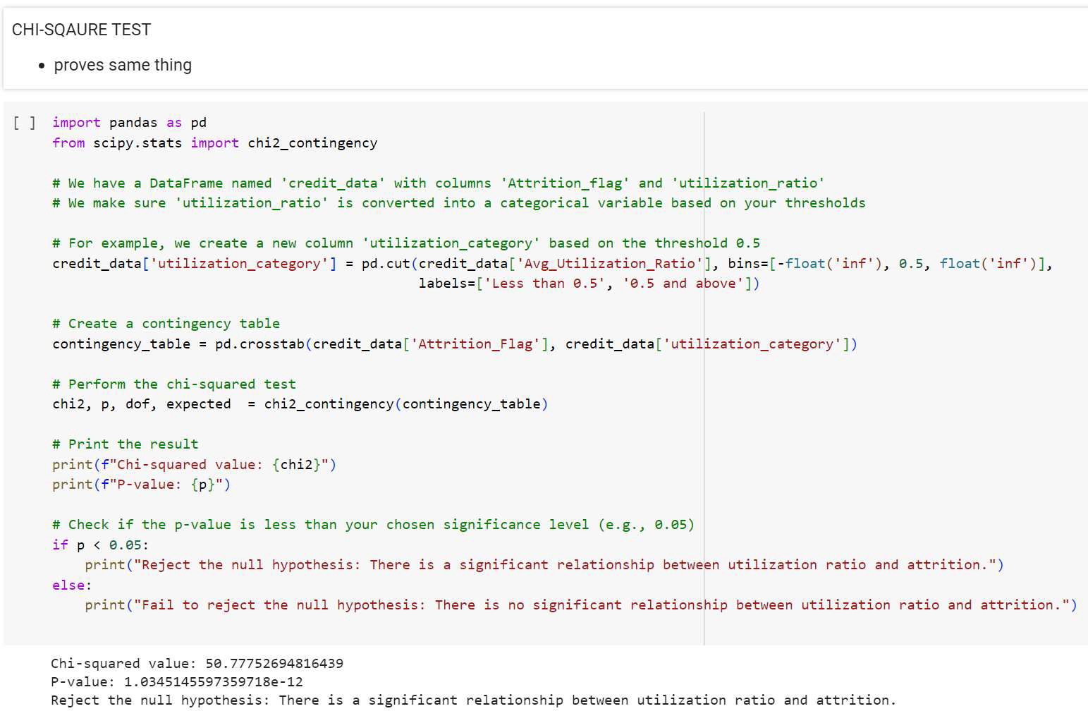
We used CHI-square test as well to test our hypothesis and it also gave the same result.

Slide 22
Conclusion
Gender and Credit Limits:
Initial hypothesis of higher male representation in credit limits > $25,000.
Evidence suggests no strong correlation; gender might not be a decisive factor.
Emphasis on variables like education level and income influencing credit limits.
Utilization Ratio and Customer Attrition:
Logistic regression model highlights substantial impact of utilization ratio on attrition probability.
Coefficient for 'utilization_less_than_0.5' is statistically significant, indicating higher attrition for ratios < 0.5.

Slide 23
Recommendations for Business Strategies:
Targeted Engagement Strategies
Personalized Offerings
Proactive Customer Retention
Utilization Education
Continuous Monitoring and Adaptation

Slide 24
Limitations and Future Work:
Representativeness and Quality of Data:
The results might not be entirely representative of the larger customer base.
Temporal Dynamics:
The analysis is predicated on a moment in time in which customer data was captured. Customer behavior shifts over time, impacted by outside variables or the state of the economy, are not fully recorded.
Correlation versus Causation:
Although the analysis shows a correlation between utilization ratios and attrition, more research is needed to determine the cause. The relationship could be muddled by additional unobserved factors.

Slide 25
Ideas for Further Study / Additional Data Gathering:
1. Analysis of Longitudinal Data
2. Multivariate Evaluation
3. External Verification
4. Models for Machine Learning

Slide 26
Thank you!

